Slide 1

Source Code Configuration at CCS

Slide 2

Session Goals
Code Configuration Management
  Need for version controlling
  Version controlling with Subversion(svn)
  Process implementation in current environment
  Problems with current version controlling system
  A typical scenario
  Proposed Solution
  Implementation
  When do we need branching?
  Load generation – Pre tasks
  Load generation – Post tasks

Slide 3
Code Configuration Management

Slide 4
Need for Version Controlling
Multiple developers working on same project ends up having different versions of the original project in the local working copy.
The changes done by each developer has to be manually copied to the main version before an integrated load can be build up.
High probability of error in configuring the final build.
All the changes has to be manually incorporated in the main copy
Main Version
Manual Copy
Manual Copy
Manual Copy
Developer-1 copy
Developer-2 copy
Developer-n copy

Slide 5
Version controlling with Subversion(svn)
svn maintains a centralised repository of the project’s main copy from which multiple developers can extract a working copy to their local machine.
svn keeps track of all the changes done by multiple developers and can automatically merge them with the main copy.
Each developer “check out” a copy of the main project from the svn repository to their local machine.
After doing the necessary changes a developer sends all those changes to the repository through a process called “commit”.
If another developer then wants to do a commit then svn prevents it since the copy he/she is working is an older version and the developer has to get all the recent changes that has been done by other developer(s). This is done through a process called “update”.
Once all developers has done their commits (after proper updation the copy in the Build Server is updated and load is generated.

Slide 6
Version controlling with Subversion(contd…)
Repository
Build Server
UPDATE
Load Generation
Update
Commit
Checkout (1 time)
Checkout (1 time)
Update
Commit
war file
Developer-1 working copy
Developer-2 working copy

Slide 7
Process implementation in current environment
The url of the svn is “svn://192.168.1.60/Repository” which is configured in the NetBeans IDE.
All the basic operations like checkout,commit and update can be done from the NetBeans.
As evident from the url the svn repository is situated in the machine 192.168.1.60 (CCS7).
The svn server has to be switched on prior to performing any of the svn operations.
Load is generated from the CCS7 machine.
A copy of load is archived in the CCS7 machine (location specific to projects and client) and released for internal testing.
If the testing succeeds the load is archived in the CCS8 machine from where it is released to client.

Slide 8
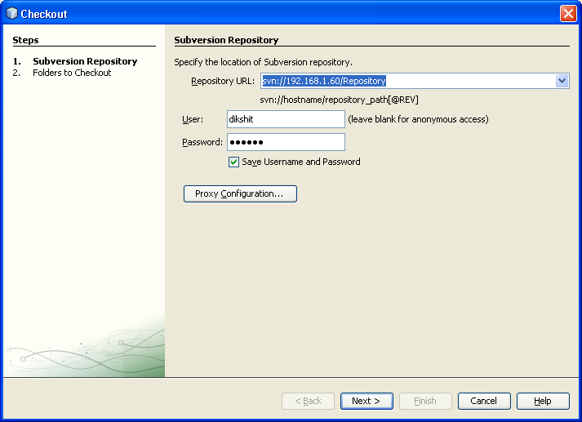
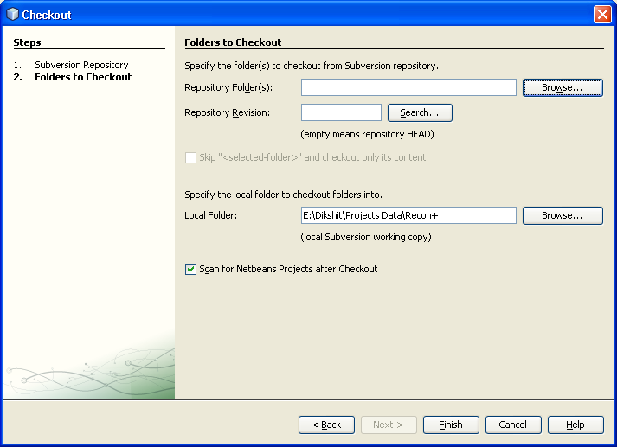
Checkout process

Slide 9
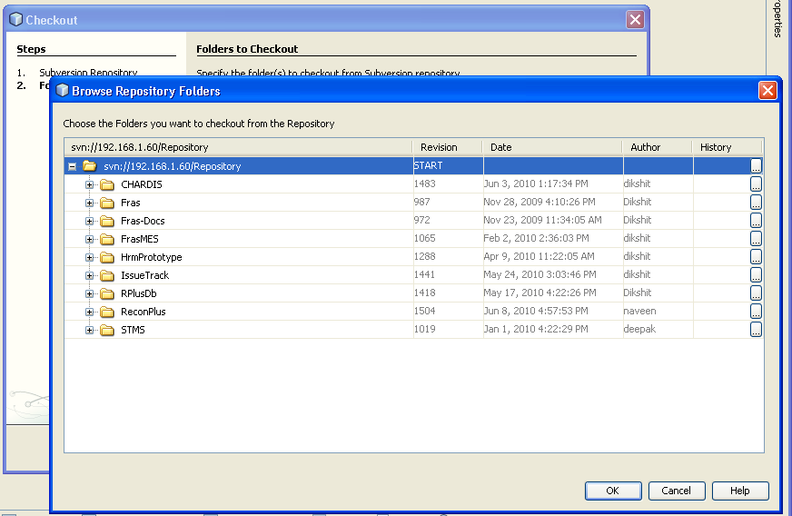
Checkout process

Slide 10
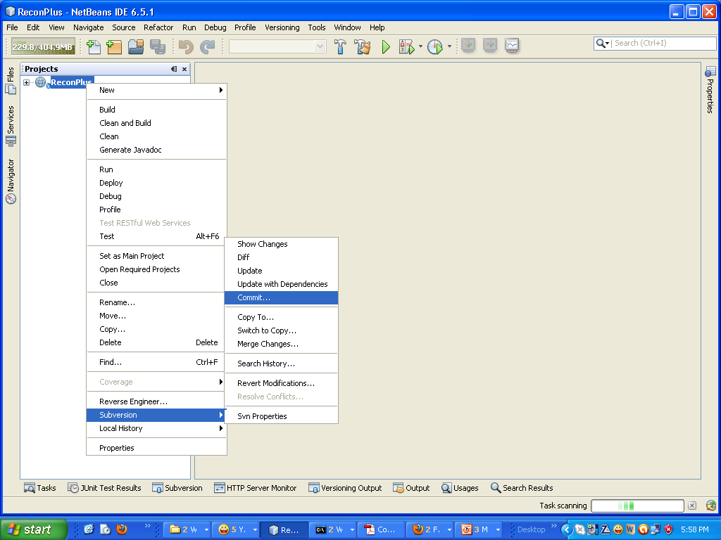
Commit

Slide 11
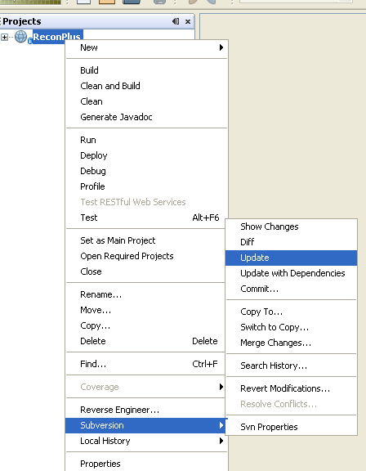
Update

Slide 12
Problems with current version controlling system
All working copies are directly linked with the main branch of the repository.
A commit by any developer directly impacts the main branch.
Load generation is done less frequently than the commits. This makes the source code of the main branch out of sink with the source code of the load at production.
Although it is possible to extract the source code version corresponding to a particular load from the repository but the process comes with lots of error prone manual configuration when any changes is done to the old version and the same needs to me merged back to the main branch.
Problems escalates in the event of multiple production and multiple developers.

Slide 13
A typical scenario
Day 0 – Developer check out a copy from the repository
Day 1 – Developer do the changes and commits. Load generated from the Build Server. Source code of load and main branch in synch.
Day 2 – No commits and load generation.
Day 3 - Developer commits all the changes done since last commit at Day 1. This directly affects the main branch. The main branch code is now not in synch with the load at production.
Day 4 – A minor but important bug appears in the production load. The main branch is now out of synch and the newly committed enhancements hasn’t been tested yet.
“How will you now fix the bug and do a quick release???”

Slide 14
Load in sink with main branch
Load
Load not in sink with main branch
Load generated
On Day1
Main Branch
Commit on day 0
Day1
Day2
Day3
Day4
Day0
Commit on day 1
Working Copy
Commit on day 3

Slide 15
Proposed Solution
The general and most widely used solution to the problem is branching and merging.
Branching :- A new branch is created from the main line of code in the repository.
Developers are now given a working copy of the branch.
All the commits and updates are now from the branch and the main line is unaffected.
Thus we can queue up all the changes before updating them in the main branch.
Multiple branches can be created from the main line.
Once a branch line is completely tested it is then “merged” in the main line.
Load is then generated from the main line.
Load then undergoes testing.
Once the load passes testing it is released for production
A copy of main line is kept separately for emergency rollback under a line called Production.
This copy is generated at the same time the load is released for production.

Slide 16
Enhancement Versions
The enhancement branch will be merged with the main line only after complete testing (along with the changes in main branch)
Working Copy
WorkingCopy
Load
Load Generated
Load Generated
In Synch
In Synch
In Synch
In Synch
In Synch
In Synch
Main Branch
Day0
Day1
Day2
Day3
Day4
Merge bug fixes
Day5
WorkingCopy
Bug-Fix Version

Slide 17
Illustration of the concepts
The following slides illustrates the proposed solution along with their implementation for a demo project titled “BranchingDemo”

Slide 18
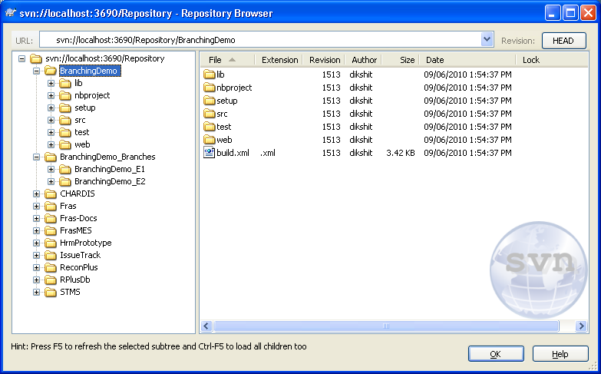
Implementation - Branching
Main Line
Branches

Slide 19
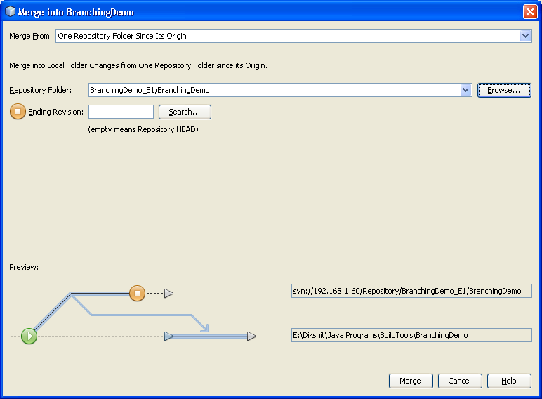
Implementation - Merging
All the changes are queued up in this branch
Changes are then merged with the main branch

Slide 20
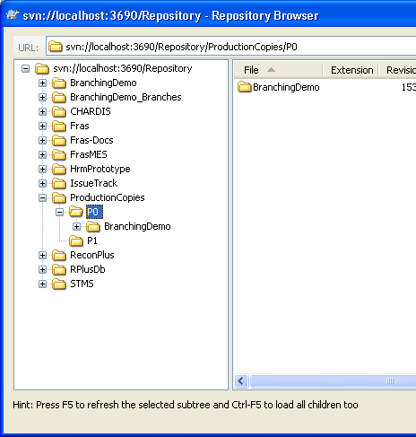
Implementation – Production copies
Copies of production load for immediate roll back and RCA

Slide 21
When do we need branching ?
During enhancement
During bug fixes
Post deployment – so that further changes don't affect the main branch. This branch will be maintained separately under a branch called “Production Copies”.

Slide 22
Pre Task
These pre-tasks are to be followed by each developer
Tasks | States
 | Enhancements | Bug Fixes
 | Delete all your previous working copy after taking proper back up (Ideally you should have only working copy unless you are simultaneously working on two different lines) | Delete all your previous working copy after taking proper back up (Ideally you should have only working copy unless you are simultaneously working on two different lines)
 | Extract the proper branch from svn | Extract the proper branch from svn
 | Interim commits and updates should be to/from the branch | Interim commits and updates should be to/from the branch
 | Do a full round of testing before declaring all your assignments as closed | Do a full round of testing before declaring all your assignments as closed

Slide 23
Post Tasks
Post tasks to be followed by each developer after completion of the assigned works and ready to queue up the changes for merging in the main branch
Tasks |  | States
 | # | Enhancements | Bug Fixes
 | 1 | Do a full round of testing before declaring all your assignments as closed | Do a full round of testing before declaring all your assignments as closed
 | 2 | Take a local back up copy | Take a back up copy
 | 3 | Merge all the recent changes from other completed branches | Merge all the recent changes from other completed branches
 | 4 | Do a full integration testing | Do a full integration testing
 | 5 | If the test fails revert to the local back up copy and analyse else continue from step 7 | If the test fails revert to the local back up copy and analyse
 | 6 | Repeat steps 1 through 5 | Repeat steps 1 through 5
 | 7 | Release your version for merging to the main branch | Release your version for merging to the main branch

Slide 24
Deployment – Pre tasks
These tasks are to be done in the build server
# | Tasks
1 | Make sure that the branches where all the new changes are queued up are properly tested.
2 | Merge all the changes to the main copy from the queues.
3 | Do a full round of integration testing.
4 | If the testing fails then immediately revert the main branch back to the latest P(x) copy.
5 | If the testing succeeds generate the load and branch the main copy to the Production Copies ,P(x) folder.

Slide 25
Deployment– Post tasks
# | Tasks
1 | Archive the load file in the CCS7 machine (location specific to projects and clients
2 | Archive the same version in the CCS8 machine.
3 | Release the load to the client through CCS8

Slide 26
Restoration to a previous point
Problem – To revert back to a previous version incase some wrong commits have been done
Solution – svn has got a feature by which all the changes done from a particular point can be deleted. This feature comes under “Revert Modifications”
With this feature one can revert back to a previous version undoing all the new changes
“Caution ! This is an irreversible process so must be done only when extreme necessary and under expert guidance. Although the procees can be reversed but it call for a lot of configuration and hence practically irreversible”

Slide 27
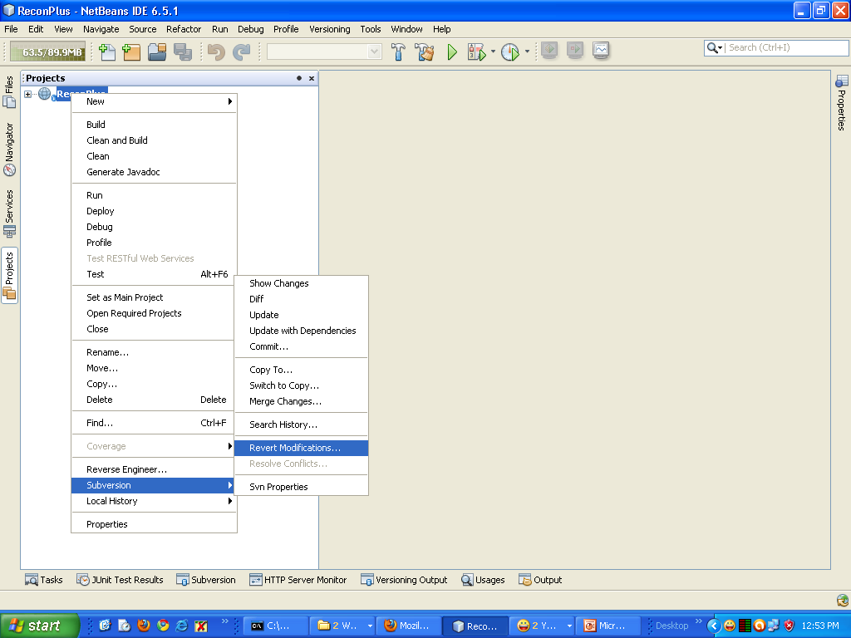
Restoration to a previous point (contd…)

Slide 28
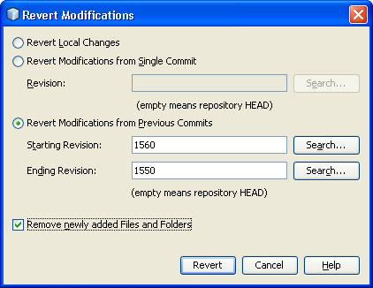
Restoration to a previous point (contd…)
Revert all the changes done from commits from revision 1550-1560

Slide 29
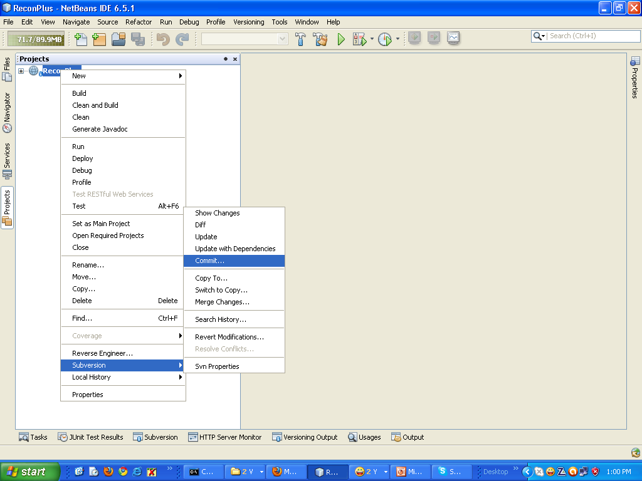
Restoration to a previous point (contd…)
Commit the code so that the deleted code doesnot appears in the head revision

Slide 30
Business Continuity Planning

Slide 31
Definition & Need
Business continuity planning (BCP) is the creation and validation of a practiced logistical plan for how an organization will recover and restore partially or completely interrupted critical (urgent) functions within a predetermined time after a disaster or extended disruption.
In the current scenario the need for a strong BCP is to ensure that in case of a system crash or data crash the data can be recovered at a minimal time with practically zero loss.
The current environment needs a strong and effective backup strategy

Slide 32
Points of failure
System crash
Data corruption

Slide 33
What to backup
Source code along with the branches cum the Production Load copies P(x).
Database

Slide 34
Backup plan
Since all the source code along with the production copies ,P(X)s are maintained in the svn repository hence backing up only the repository is all we need.
The backup will be scheduled to run automatically at various time of the day.
There will be two sets of backup
  Backup to local machine
  Backup to a remote machine.
All the backups will be a full backup.
Apart from these there will also be a manual backup which will simply zip up the repository folder.

Slide 35
Recovery Plan
The backed up files will be tested once a week preferably on weekends as a mock drill to ensure that files are backed up properly.
In case of failure to recover the current files will checked for any inconsistency and a manual backup will be done.
The automated backup will be reviewed to find out various caused of failure.

Slide 36
Proposed Back Up Plan (Partially activated)
Local backup (Daily)
New machines
User-a
Local backup (Daily)
User-b
Daily
Daily
Daily
Local backup (Daily)
CCS7
(Repository)
Daily
CCS4
Local backup (Daily)
User Initiated
User Initiated (Preferably weekly)
Offline Storage
SS

